Slide 1
Counselor’s Corner 2023 - 2024
Notes:
Add your School Name or be creative with a title

Slide 2
Counseling Team
Ms. Nuria Clarke
9th & 10th Grade
A - GO
Ms. Devyani Balladin
9th & 10th Grade
Gr - Pe
Ms. Imaris Morales
9th & 10th Grade
Pi - Z
Ms. Shaniqua Wilkerson
11th & 12th Grade
A - D
Ms. Deysi Ortiz
11th & 12th Grade
E - L
Ms. Adriana Zuniga
11th & 12th Grade
M - Re
Mr. Larry Warren
11th & 12th Grade
Ri - Z

Slide 3
How do I see my counselor?
1. Report to the counseling building.
2. Complete the appointment QR Code or form located in the counseling department.
3. Patiently wait for the counselor to call you! Note- walk-in sessions are not always guaranteed.

Slide 4
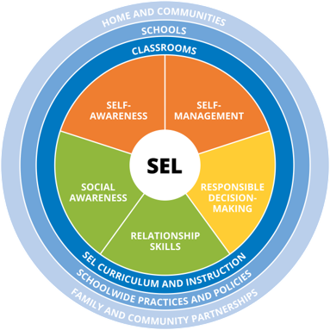
Personal & Social
Mental Health is critical! Please balance yourself and report anything appears to be unsafe.

Slide 5
Extracurricular Activities
Athletics:
Basketball
Soccer
Football
Baseball & Softball
Wrestling
Tennis
Cross Country
Track & Field
Flag Football
Volleyball
Fine Arts:
Theater/Plays
Chorus
Concert Band
Marching Band
Color Guard
Clubs:
Various activities/organizations exists! Please see Mr. Bryant if you are interested in forming a club that is not offered. Clubs will begin in September.

Slide 6
Building Relationships w/ Teachers!
How so?
Comply with school/classroom expectations
Complete all required assignments
Arrive on time to class
Participate in after school events
Make an appointment w/ your teacher to discuss your future aspirations
Ask teachers questions!
Why is this important?
Teacher Recommendation Letters for college entrance
Teacher Recommendation Letters for special programs
Teachers can assist with tutoring and extra help (when needed)

Slide 7
Know the Adults!
Get to know the adults on campus!
If you see something, say something!
This includes bullying, harassment, mental health issues, psychological distress, and/or anything unsafe on campus.
Every adult has an important purpose on campus, so please be respectful to everyone’s work and dedication to Osceola High School.
Adults on campus can assist you by helping to problem-solve your situation.

Slide 8
Credit Checks
It is important to stay in contact with your counselor to review your credit checks.
Counselors conduct annual (1 time) credit checks for 9th Grade students in February. (You may seek a credit check at any time)
Remember- pass your classes so that you can stay on track to graduate!

Slide 9
Suicide Prevention Line

Slide 10
MTSS Behavior
For those who receive a significant amount of discipline referrals, you may be placed in behavior intervention sessions with the counselors to problem-solve your current reality to a positive!

Slide 11
Thanks!
Any questions?

